Slide 1
BASIC WORKFLOW:

Slide 2
Local
Remote

Slide 3


Local
Remote
Local Git
Remote Git
Git tracks the changes we make to files on our local machine, e.g. our computer.
Git allows us to store our files and history remotely which can then be accessed on other devices.

Slide 4

Local
Remote
Local Repo
Remote Repo
Git Repository
This is where Git tracks and records all the changes made to the files in our project.

Slide 5


Local
Remote
Working Directory
Local Repo
Remote Repo
Working Directory
This is the location in which we work and save our files.

Slide 6

Local
Remote
Working Directory
Local Repo
Remote Repo
Staging Area
git add
Staging Area
Any changes we make to a file that we want Git to track we first add to the staging area using the command git add

Slide 7

Local
Remote
Working Directory
Local Repo
Remote Repo
Staging Area
git add
git commit
Commit Changes
We can then commit any changes in the staging area using the command git commit

Slide 8

Local
Remote
Working Directory
Local Repo
Remote Repo
Staging Area
git add
git commit
git push
Push to Remote Repo
We can push any new changes committed in our local repo to the remote repo using the command git push

Slide 9

Local
Remote
Working Directory
Local Repo
Remote Repo
Staging Area
Pull from Remote Repo
git add
Similarly, we can update and merge with our local repo by pulling from the remote repo using the command git pull
git commit
git push
git pull

Slide 10

Local
Remote
Working Directory
Local Repo
Remote Repo
Staging Area
git add
git commit
git push
Working on a Branch
git pull
It is good practice to use branching: to work on a particular branch we use the command git checkout
git checkout

Slide 11
Local
Remote
Working Directory
Local Repo
Remote Repo
Staging Area
git add
git commit
git push
git pull
git checkout

Slide 12
VISUAL FOR COMMITTING CHANGES

Slide 13
Local
Staging Area
Local Repo
Working Directory
Untracked files:
example.txt

Slide 14
Local
Staging Area
Local Repo
Working Directory
git add
example.txt
new file: example.txt

Slide 15
Local
Staging Area
Local Repo
Working Directory
git commit
example.txt
new file: example.txt
example.txt

Slide 16
Local
Staging Area
Local Repo
Working Directory
example.txt
example.txt

Slide 18
Local
Staging Area
Local Repo
Working Directory
Modified files:
example.txt
example.txt

Slide 19
Local
Staging Area
Local Repo
Working Directory
example.txt
(modified)
git add
modified: example.txt
example.txt

Slide 20
Local
Staging Area
Local Repo
Working Directory
example.txt
(modified)
git commit
modified: example.txt
example.txt

Slide 21
Local
Staging Area
Local Repo
Working Directory
example.txt
(modified)
example.txt
(modified)
example.txt
(previous version)

Slide 22
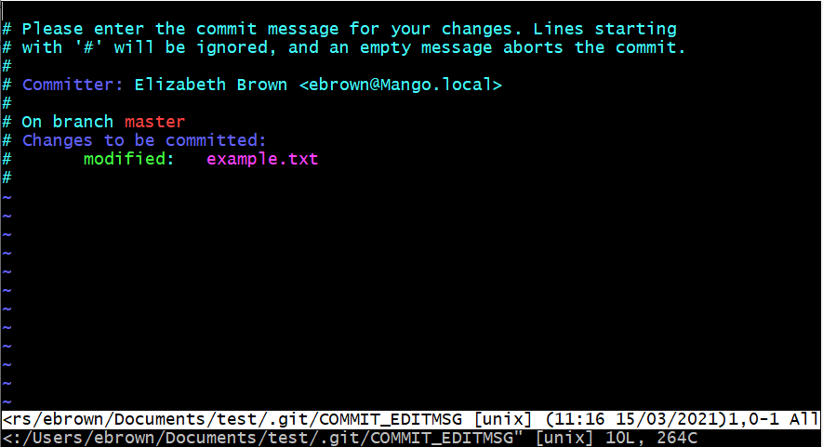
XXXXXXXXXXXXXXXXXXXXXXXXXXXXXXXXXXXXXXXXXXXXXXXXXXXXXXXXXXXXXXXXXXXXXXXXXXXXXXXXXXXXXXXXXXXXXXX
XXXXXXXXXXXXXXXXXXXXXXXXXXXXXXXXXXXXXXXXXXXXXXXXXXXXXXXXXXXXXXXXXXXXXXXXXXXXXXXXXXX

Slide 23
Revert changes workflow

Slide 24
This is the most recent commit which represents the current version of, e.g., a file

Slide 25
We want to revert the file back to its previous version represented by this previous commit

Slide 26
git revert

Slide 27
This new commit represents the changes made in order to revert the file

Slide 28
The file is in the same condition for both these commits

Slide 29
Note that we have not lost any of the file’s commit history

Slide 30
Intro to branching workflow

Slide 31
Main branch
Development work is being carried out on this branch

Slide 32
New feature
Main branch
While working on this branch, a new branch could be created, e.g. to develop a new feature.

Slide 33
New feature
Main branch
Another branch could then be created to fix a bug
Bug fix

Slide 34
Now there are three pieces of independent development work being carried out alongside each other

Slide 35
Summary workflow for working on a branch

Slide 36
master
We would like to create a new branch

Slide 37
master*
new_branch
git branch new_branch
master* tells us that we are still working on the master branch

Slide 38
master
new_branch*
git checkout new_branch
We have now switched to the branch new_branch

Slide 39
new_branch*
master
git add ; git commit
Committing a change is now done on new_branch

Slide 40
new_branch*
“new_branch is ahead of master branch by 1 commit”
master

Slide 41
new_branch
master*
git checkout master
We can then switch back to the master branch to continue work there

Slide 42
Introduction to merging workflow

Slide 43
new_branch
master*
We would like to merge the branch new_branch into the master branch

Slide 44
new_branch
master*
We would like to merge the branch new_branch into the master branch
To do this we need to be on the master branch, which we are, indicated by master*

Slide 45
new_branch
master*
git merge finds a common commit and merges the branches from there

Slide 46
new_branch
master*
Common commit
git merge finds a common commit and merges the branches from there

Slide 47
git merge new_branch

Slide 48
new_branch
master*
Merge commit
Now we have a merge commit on the master branch

Slide 49
new_branch
Finally, we might want new_branch to point to the merge commit as well
master*
Merge commit

Slide 50
git checkout new_branch
git merge master

Slide 51
master
new_branch*

